Slide 1
MACHINE LEARNING CLUSTERING ALGORITHMS-PPT

Slide 2
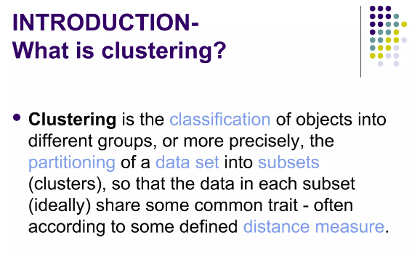

Slide 3
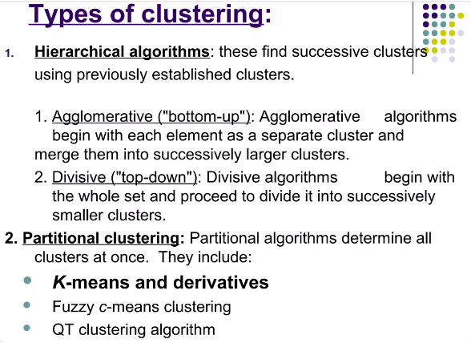

Slide 4
MACHINE LEARNING CLUSTERING K-means Clustering

Slide 5
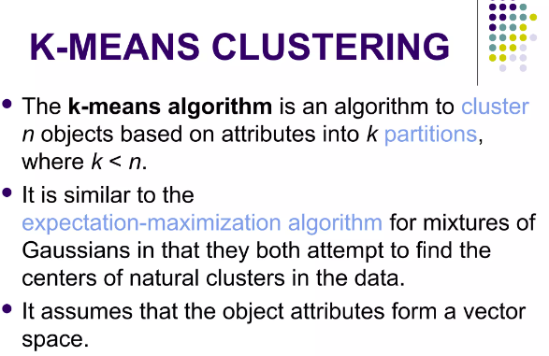

Slide 6
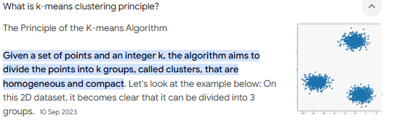

Slide 7
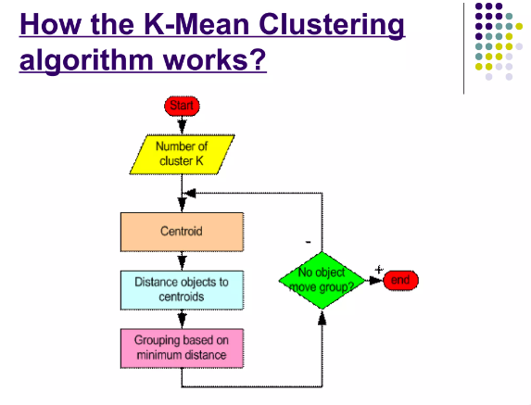

Slide 8
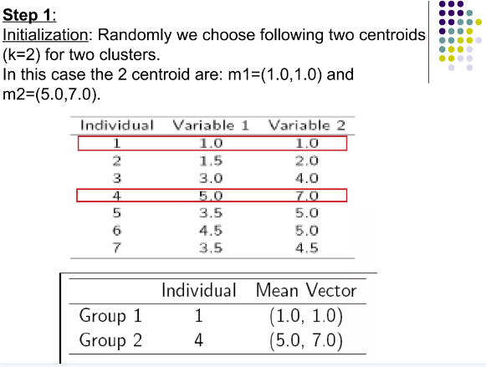

Slide 9
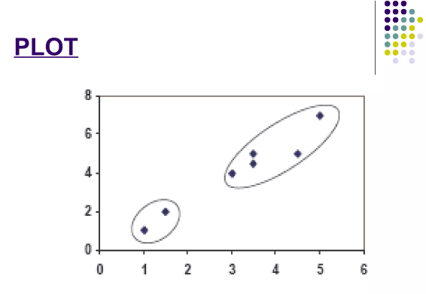

Slide 10
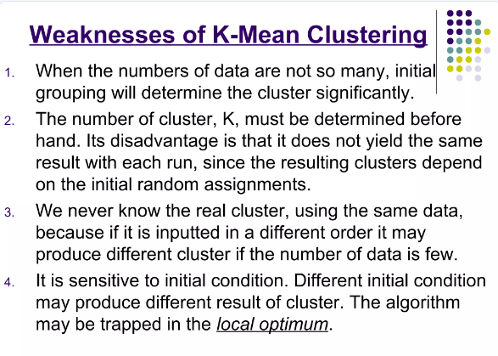

Slide 11
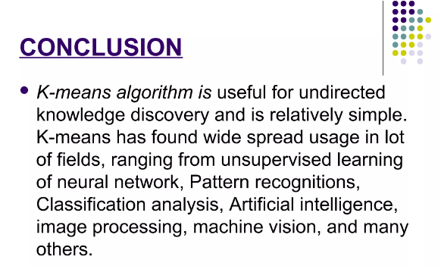

Slide 12
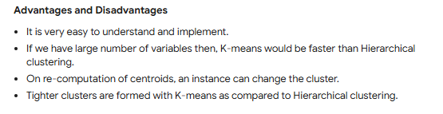

Slide 13
MACHINE LEARNING CLUSTERING Agglomerative Clustering

Slide 14
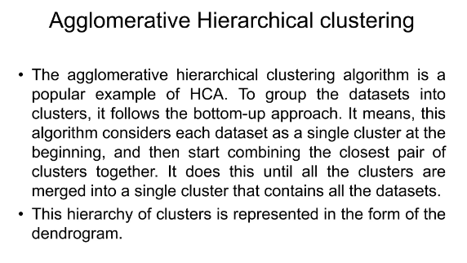

Slide 15
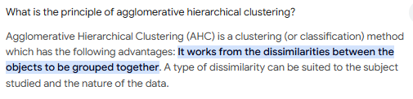

Slide 16
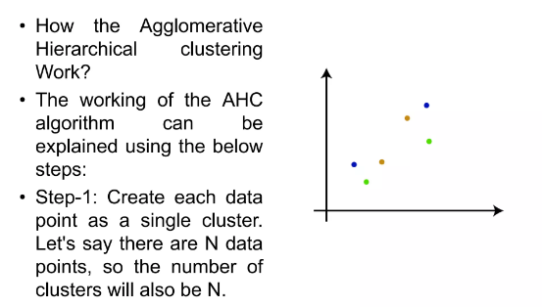

Slide 17
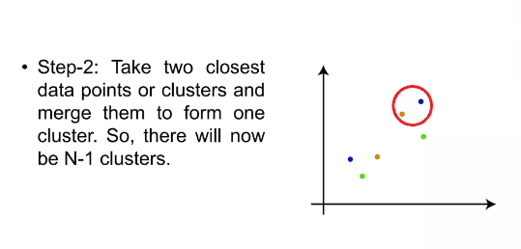

Slide 18
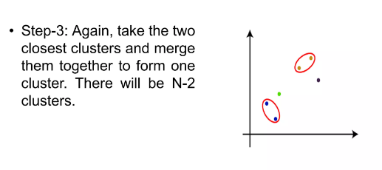

Slide 19
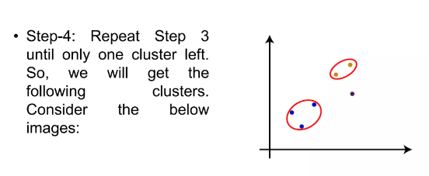

Slide 20
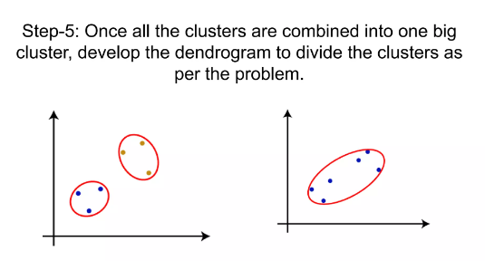

Slide 21
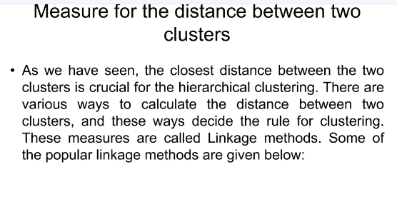

Slide 22
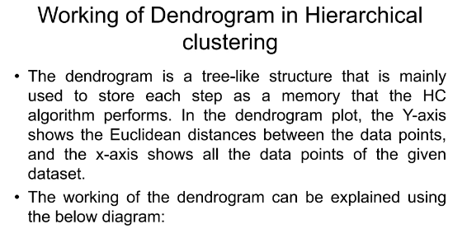

Slide 23
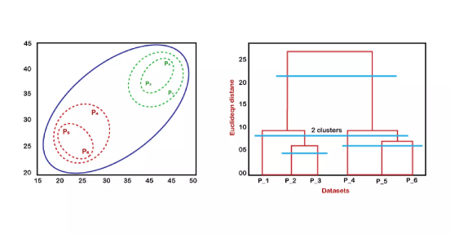

Slide 24
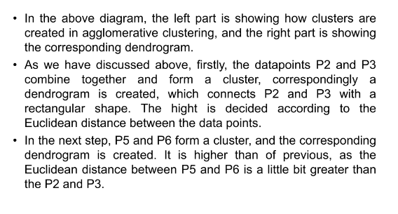

Slide 25
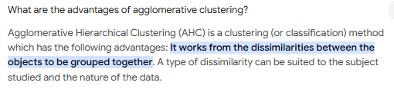
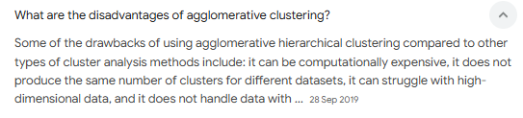

Slide 26
MACHINE LEARNING CLUSTERING Birch Clustering

Slide 27
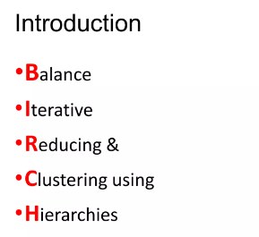
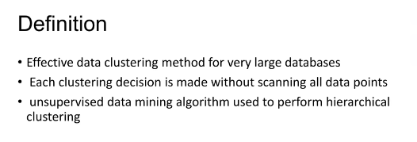

Slide 28
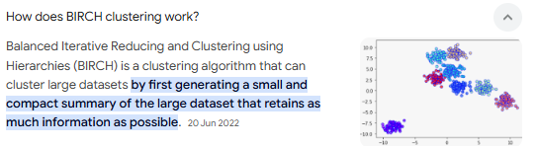

Slide 29
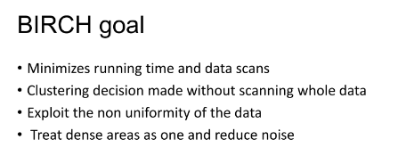
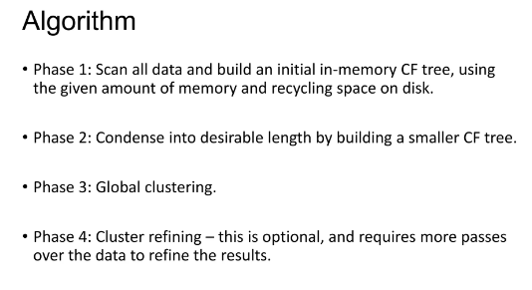

Slide 30
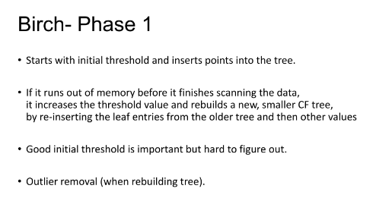
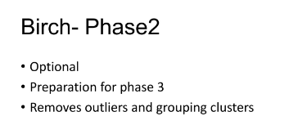

Slide 31
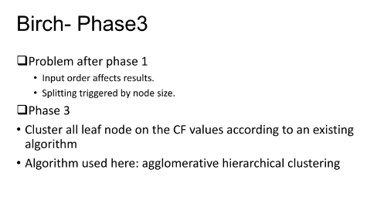
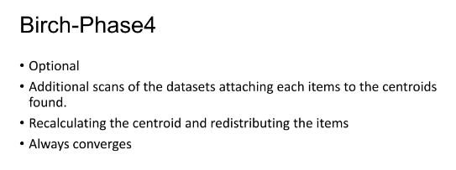

Slide 32
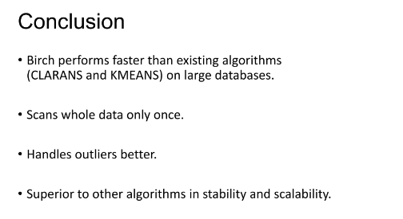

Slide 33
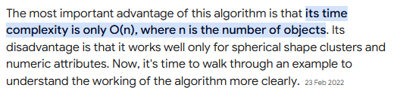
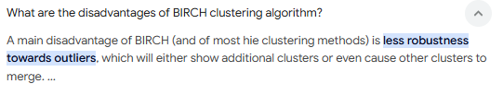

Slide 34
MACHINE LEARNING CLUSTERING Mean Shift Clustering

Slide 35
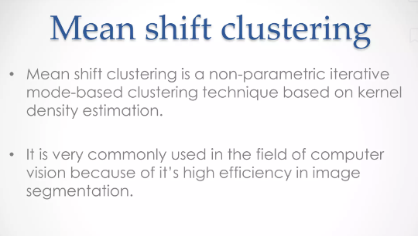

Slide 36
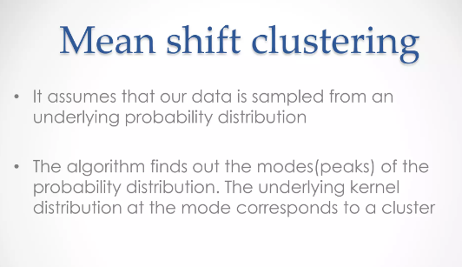

Slide 37
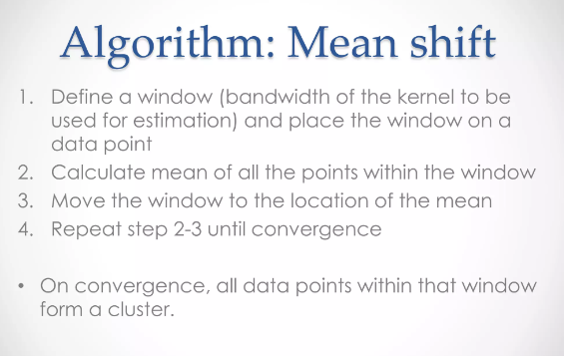

Slide 38
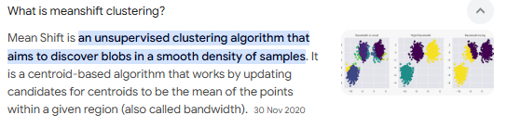

Slide 39
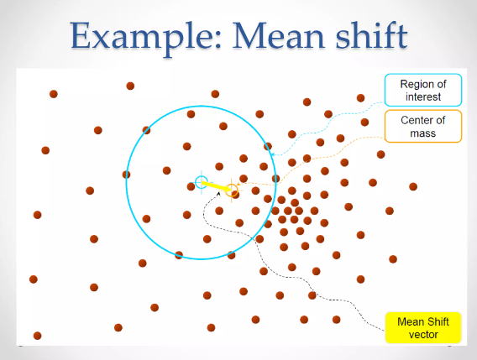

Slide 40
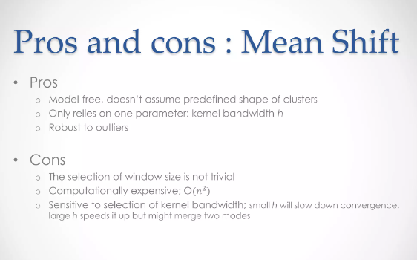

Slide 41
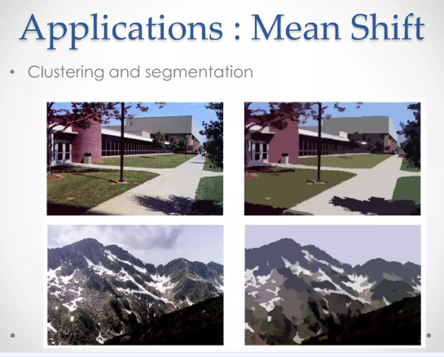

Slide 42
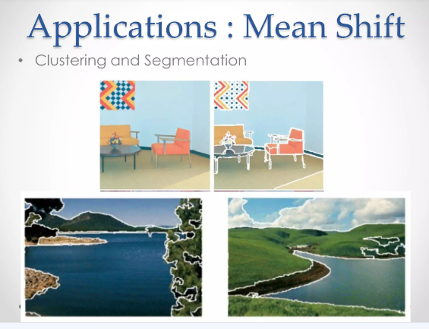

Slide 43
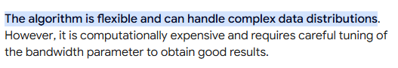
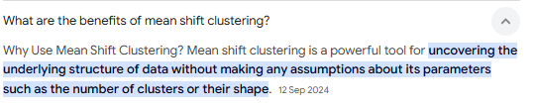
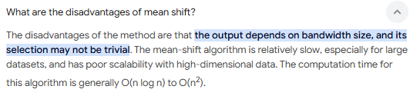

Slide 44
MACHINE LEARNING CLUSTERING Affinity Propagation Clustering

Slide 45
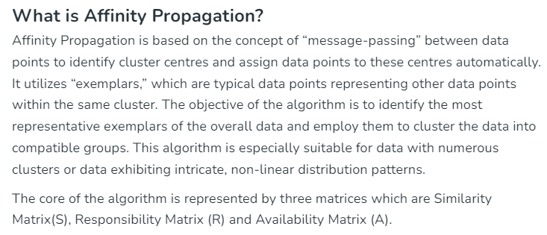
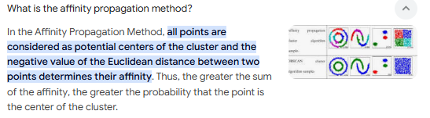

Slide 46
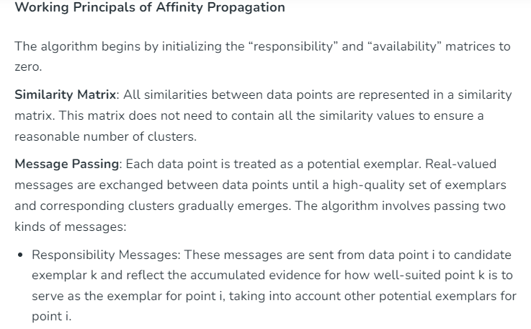

Slide 47
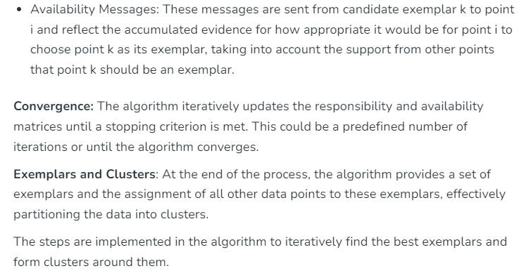

Slide 48


Slide 49




Slide 50
MACHINE LEARNING CLUSTERING DB Scan Clustering

Slide 51


Slide 52


Slide 53


Slide 54


Slide 55


Slide 56


Slide 57



Slide 58
MACHINE LEARNING CLUSTERING HDB Scan Clustering

Slide 59


Slide 60


Slide 61



Slide 62


Slide 63


Slide 64



Slide 65

MACHINE LEARNING CLUSTERING Optics Clustering

Slide 66



Slide 67



Slide 68


Slide 69


Slide 70


Slide 71


Slide 72



Slide 73
MACHINE LEARNING CLUSTERING Spectral Clustering

Slide 74


Slide 75


Slide 76


Slide 77


Slide 78


Slide 79


Slide 80




Slide 81
MACHINE LEARNING CLUSTERING Bisecting K-means Clustering

Slide 82



Slide 83


Slide 84


Slide 85


Slide 86


Slide 87


Slide 88





